Slide 1
A Donation Application
Uzair Khan K15-2183

Slide 2
Introduction
An Android application that aims to streamline the process of donations.
How?
By implementing a system to connect people who need donations with donors who can help them.

Slide 3
Features
Allows users to see their nearest donation centres according to their current location
Allows users to see and volunteer for various NGO’s
Allows charities and NGO’s to keep track of their volunteers registered through the application
Allow users to request donations for themselves or as a representative for some cause.
NGO’s and charities can get in touch with those who require donations to verify their case.
Allows other users to see various verified donation requests and get in contact with those people directly.
Letting Charities and Hospitals issue notifications to all users in case of an emergency city-wide situation.

Slide 4
Secondary features
Backend server hosted on the cloud
User credential safety by implementing Google Sign In which itself uses the OAuth 2.0 protocol both for the app and the backend server.

Slide 5
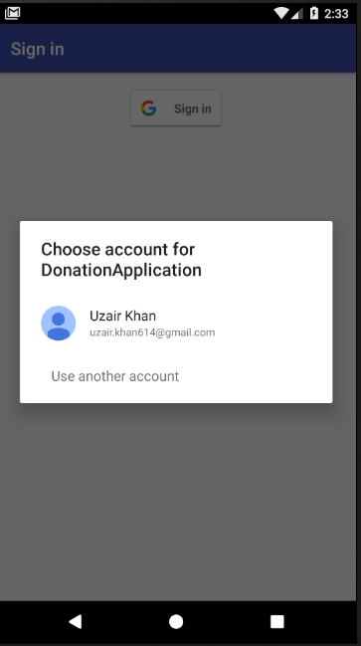
Achieved Goals
Google Sign In Authentication implemented...

Slide 6
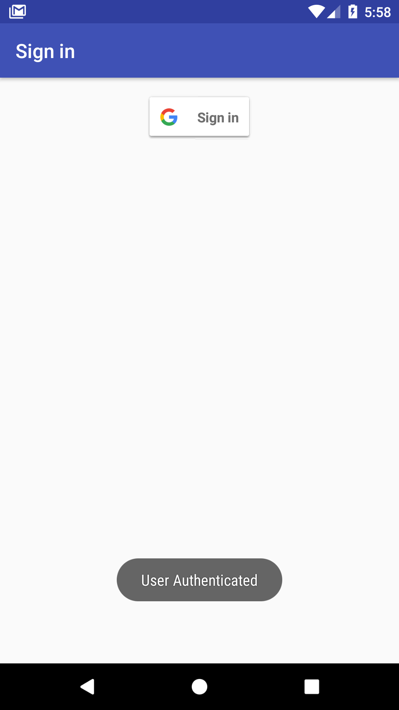
Achieved Goals
...with authentication by the backend server as well.

Slide 7
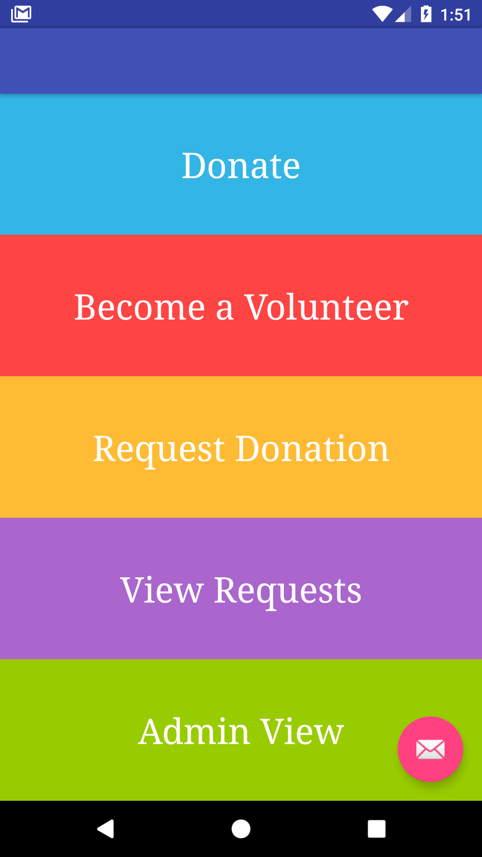
Achieved Goals
The Main Menu

Slide 8
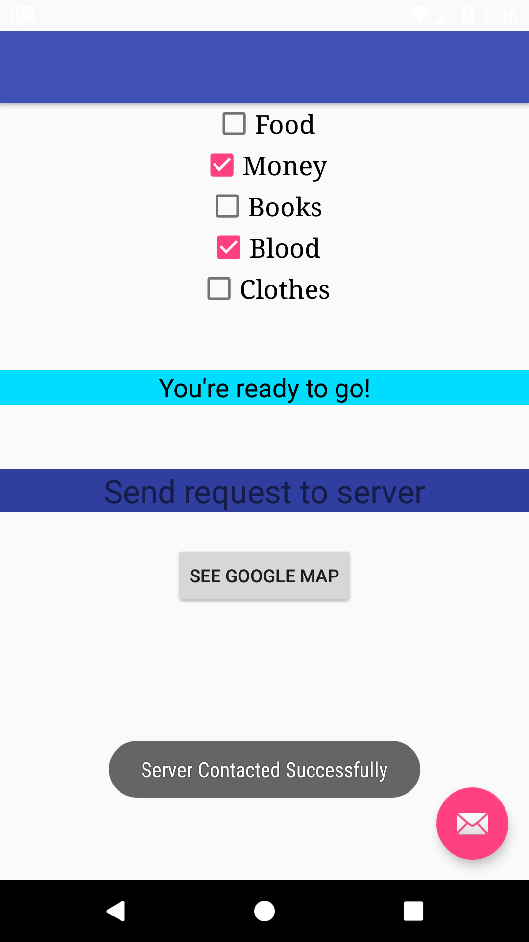
Achieved Goals
Users can select the type of donation centres...

Slide 9
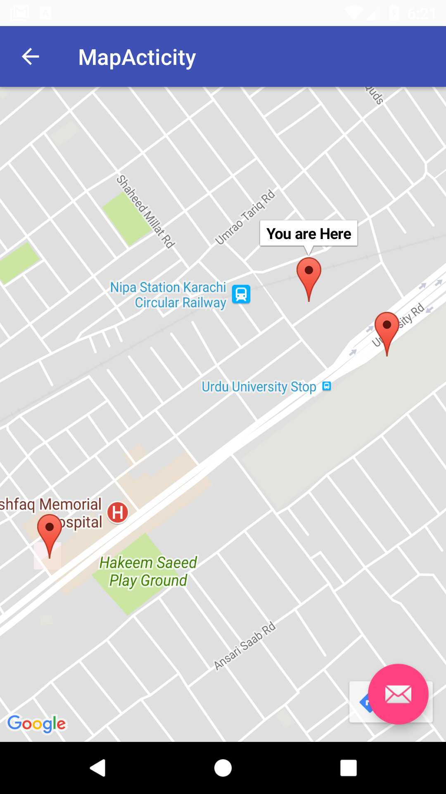
Achieved Goals
...and see the nearest donation centres according to their location...

Slide 10
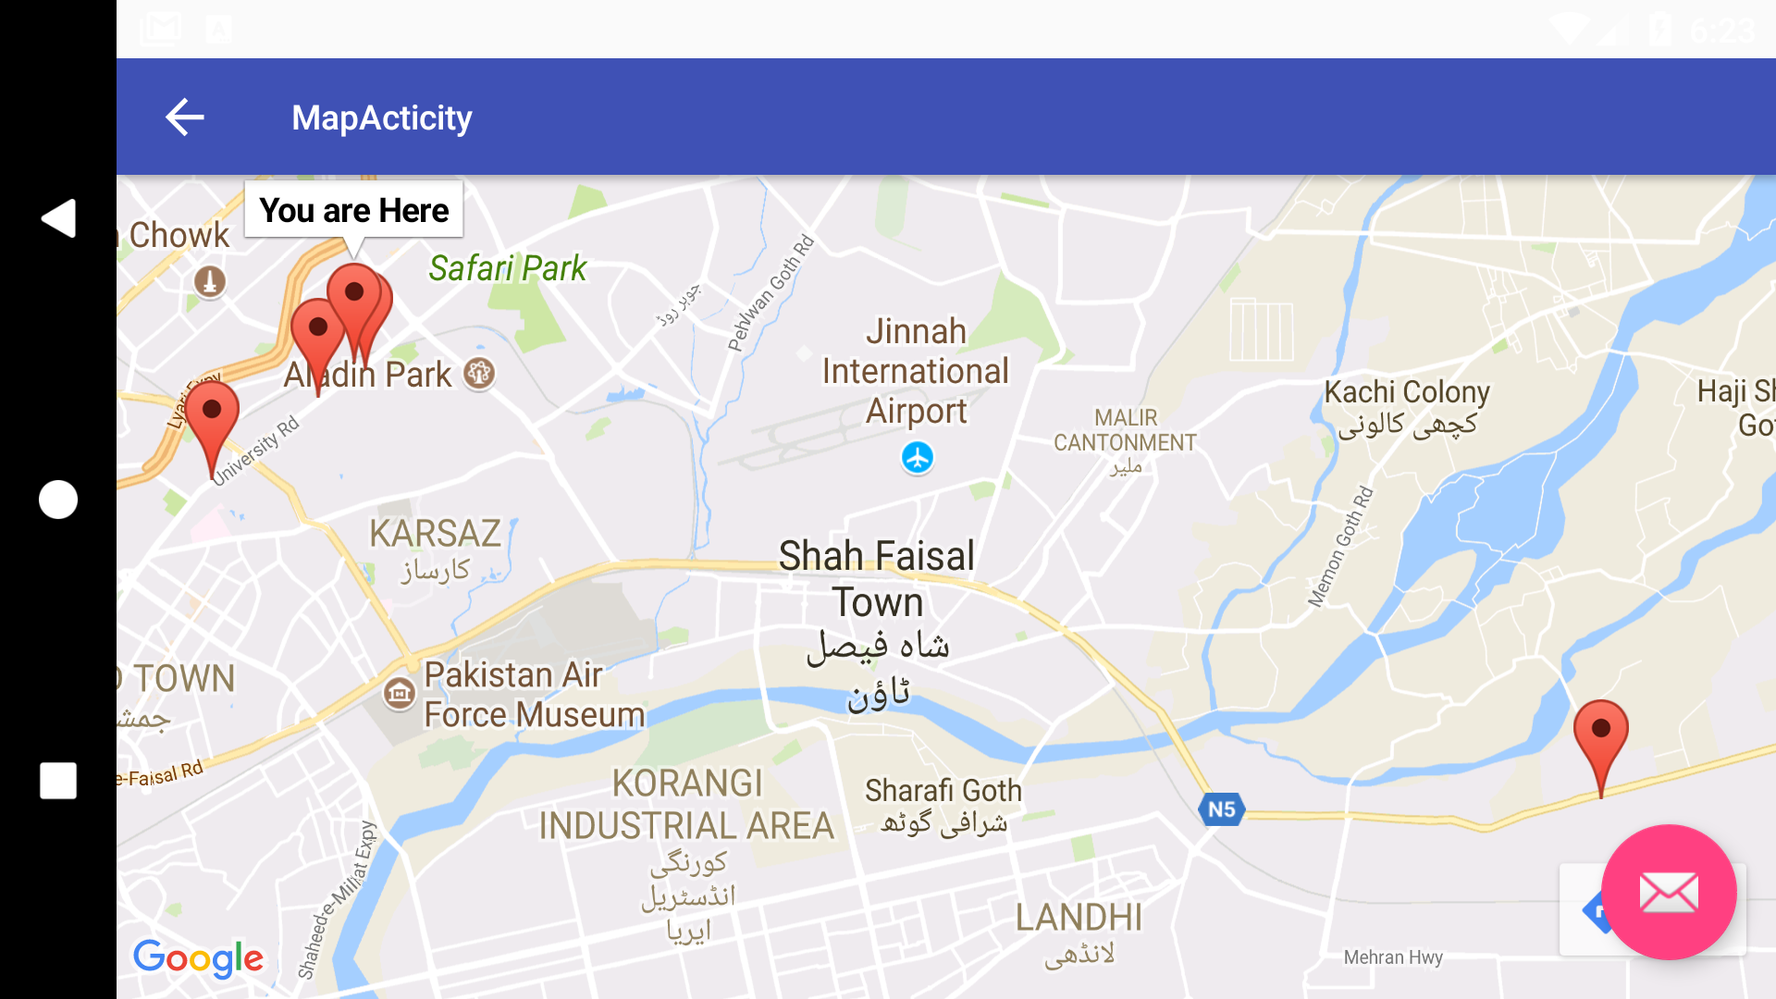
Achieved Goals
...or zoom out to get a bird’s eye view.

Slide 11
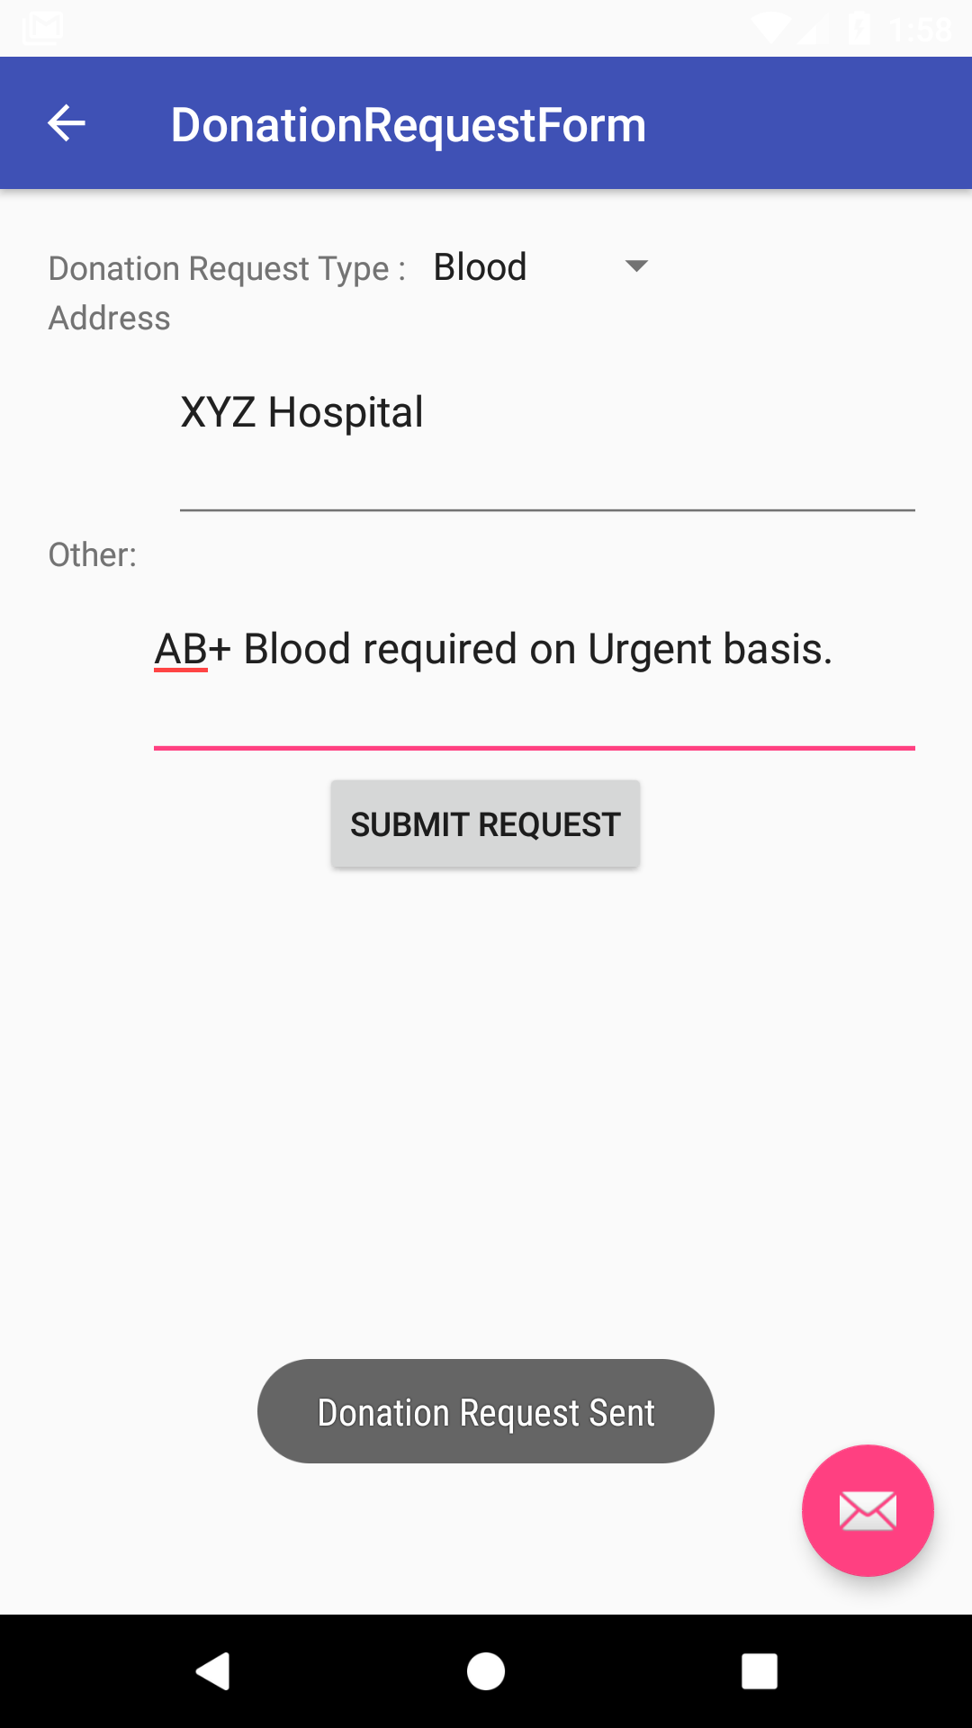
Achieved Goals
Users can also send a donation request form.

Slide 12
Work to do.
UI\UX Design
Letting NGO’s and charities view their volunteers.
Letting NGO’s and charities approve donation requests.
Allowing users to view verified donation requests.

Slide 13
Documentation
SRS completed.
SDS to be completed.
Class documentation to be completed.

Slide 14

Thanks!

